Slide 1
Introduction
Random bit streams used in key generation and encryption…
Two strategies:
Compute bits deterministically using an algorithm-Pseudo-Random Number Generators (PRNGs) or Deterministic Random Bit Generators (DRBGs).
Produce bits non-deterministically using some physical source that produces some sort of random output- True Random Number Generators (TRNGs) or Non-deterministic Random Bit Generators (NRBGs).

Slide 2
The use of Random Numbers
A number of network security algorithms and protocols based on cryptography make use of random binary numbers:
Key distribution and reciprocal (mutual) authentication schemes
Session key generation
Generation of keys for the RSA public-key encryption algorithm
Generation of a bit stream for symmetric stream encryption
Two requirements for a sequence of random numbers: randomness and unpredictability

Slide 3
The Two Approaches
There are two approaches to generating a long stream of random bits:
Using a natural random process, such as flipping a coin many times and interpreting heads and tails as 0-bits and 1-bits,
Or using a deterministic process with feedback.
The first approach is called a True Random Number Generator (TRNG);
The second is called a Pseudo-Random Number Generator (PRNG).

Slide 4
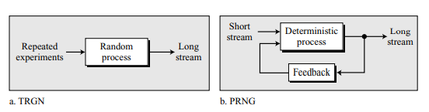
The Two Approaches

Slide 5
PRNG
A reasonably random stream of bits can be achieved using a deterministic process with a short random stream as the input (seed).
The generated number is not truly random because the process that creates it is deterministic.
PRNGs can be divided into two broad categories:
Congruential generators and
Generators using cryptographic ciphers

Slide 6
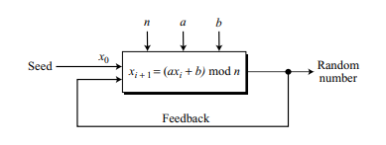
Congruential Generators: Linear Congruential Generator
This method recursively creates a sequence of pseudorandom numbers using a linear congruence equation of the form:
x_{i + 1} = (ax_{i} + b) mod n,
where x₀, called the seed, is a number between 0 and n − 1.

Slide 7
Congruential Generators: Linear Congruential Generator
The sequence is periodic, where the period depends one how carefully the coefficients, a and b, are selected. The ideal is to make the period as large as the modulus n.
Example
Assume that a = 4, b = 5, n = 17, and x0 = 7.
Find out the sequence and the period

Slide 8
Congruential Generators: Linear Congruential Generator
The sequence is periodic, where the period depends one how carefully the coefficients, a and b, are selected. The ideal is to make the period as large as the modulus n.
Example
Assume that a = 4, b = 5, n = 17, and x0 = 7.
The sequence is 16, 1, 9, 7, 16, 1, 9, 7, …, which is definitely a poor pseudorandom sequence; the period is only 4.

Slide 9
Congruential Generators: Linear Congruential Generator
Criteria for an acceptable PRNG:
The period must be equal to n (the modulus). This means that, before the integers in the sequence are repeated, all integers between 0 and n − 1 must be generated.
The sequence in each period must be random.
The generating process must be efficient. Most computers today are efficient when arithmetic is done using 32-bit words.

Slide 10
Congruential Generators: Linear Congruential Generator
Recommendation:
For selecting the coefficients of the congruence equation and the value of the modulus:
For the modulus, n, choose the largest prime number close to the size of a word in the computer being used. The recommendation is to use the thirty-first Mersenne prime as the modulus: n = M₃₁ = 2³¹ − 1.
To create a period as long as the modulus, the value of the first coefficient, a, should be a primitive root of the prime modulus. Although the integer 7 is a primitive root of M₃₁, it is recommended to use 7^{k} , where k is an integer coprime with (M₃₁ − 1). Some recommended values for k are 5 and 13. This means that (a = 7⁵ ) or (a = 7¹³).
For the second recommendation to be effective, the value of the second coefficient, b, should be zero.

Slide 11
Congruential Generators: Linear Congruential Generator
Linear Congruential Generator:
x_{i + 1} = (ax_{i} + b) mod n,
where n = 2³¹ − 1 and (a = 7⁵ ) or (a = 7¹³).
Security
Shows reasonable randomness if the previous recommendations are followed.
The sequence is useful in some applications where only randomness is required (such as simulation);
It is useless in cryptography where both randomness and secrecy are desired.

Slide 12
Congruential Generators: Linear Congruential Generator
Because n is public, the sequence can be attacked by Eve using one of the two strategies:
If Eve knows the value of the seed (x₀) and the coefficient a, she can easily regenerate the whole sequence.
If Eve does not know the value of x₀ and a, she can intercept the first two integers and use the following two equations to find x₀ and a:
x₁ = ax₀ mod n
x₂ = ax₁ mod n

Slide 13
Other Congruential Generators
Quadratic Residue Generator
To make the pseudorandom sequence less predictable.
x_{i+1} = x_{i}² mod n, where x₀, called the seed, is a number between 0 and n − 1.
Blum Blum Shub(BBS) Generator
After the names of its three inventors.
BBS uses quadratic residue congruence, but it is a pseudorandom bit generator instead of a pseudorandom number generator;
It generates a sequence of bits (0 or 1).

Slide 14
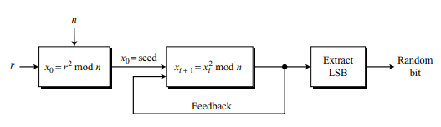
Congruential Generators: Blum Blum Shub(BBS) Generator

Slide 15
Congruential Generators: Blum Blum Shub(BBS) Generator
Steps:
Find two large primes numbers p and q in the form 4k + 3, where k is an integer (both p and q are congruent to 3 modulo 4).
Select the modulus n = p × q.
Choose a random integer r which is coprime to n.
Calculate the seed as x₀ = r² mod n.
Generate the sequence as x_{i+1} = x_{i}² mod n.
Extract the least significant bit of the generated random integer as the random bit

Slide 16
Congruential Generators: Blum Blum Shub(BBS) Generator
Security
If p and q are known, the i^{th} bit in the sequence can be found as the least significant bit of
x_{i} = x₀ ^{2 i mod [(p − 1)(q − 1)]} mod n
If Eve knows the value of p and q, she can find the value of the i^{th} bit by trying possible values of x₀ (the value of n is usually public).
This means that the complexity of this generator is the same as the factorization of n.
If n is large enough, the sequence is secure (unpredictable).
It has been proved that with a very large n, Eve cannot guess the value of the next bit in the sequence even if she knows the values of all previous bits.
The probability of each bit being 0 or 1 is very close to 50 %.

Slide 17
Cryptosystem-Based Generators
A cryptosystem such as an encryption cipher or a hash function can also be use to generate a random stream of bits.
ANSI X9.17 PRNG
A cryptographically strong pseudorandom number generator.
The generator uses three 3DES with two keys (encryption-decryption-encryption.

Slide 18
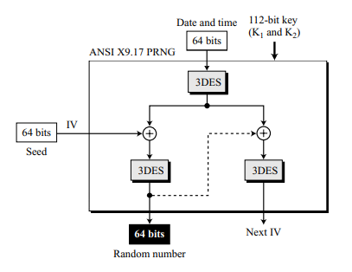
Cryptosystem-Based Generators: ANSI X9.17 PRNG
Fig: The Cipher-Block Chaining (CBC) mode
Note that the first pseudorandom number uses a 64-bit seed as the initial vector (IV);
the rest of the pseudorandom numbers use the seed shown as the next IV.
The same 112-bit secret key (K₁ and K₂ in 3DES), are used for all three 3DES ciphers.

Slide 19
Cryptosystem-Based Generators: ANSI X9.17 PRNG
Uses two stages of the block chaining.
The plaintext for each stage comes from the output of the first 3DES, which uses the 64-bit date and time as the plaintext.
The ciphertext created from the second 3DES is the random number.
The ciphertext created from the third 3DES is the next IV for the next random number.

Slide 20
Cryptosystem-Based Generators: ANSI X9.17 PRNG
The strength of X9.17 can be due to the following facts:
The key is 112 (2 × 56) bits.
The date-and-time input of 64 provides a good timestamp preventing replay attack.
The system provides an excellent confusion-diffusion effect with six encryptions and three decryptions.

Slide 21
Cryptosystem-Based Generators: PGP PRNG
PGP PRNG
Uses the same idea as X9.17 with several changes:
PGP PRNG uses seven stages instead of two.
The cipher is either IDEA or CAST-128.
The key is normally 128 bits. PGP PRNG creates three 64-bit random numbers: the first is used as the IV secret (for communication using PGP, not for PRNG), the second and the third are concatenated to create a 128-bit secret key (for communication using PGP).

Slide 22
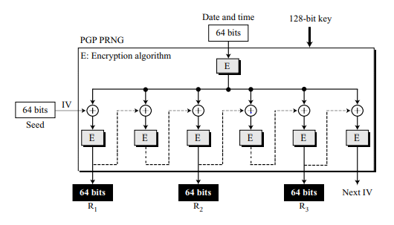
Cryptosystem-Based Generators: PGP PRNG
The strength of PGP PRNG is in its key size and in the fact that the original IV (seed) and the 128-bit secret key can be generated from a 24-byte true random variable.

